Slide 1
PORTFOLIO OPTIMIZATION
Lorenzo Giacobbe 124585

Slide 2
Portfolio optimization and modern portfolio theory
When we decide to invest in financial markets most of the time we try to optimize our investment. This is possible considering two different approaches :
Maximize our return for a given level of risk
Minimize the risk for a given return

Slide 3
In the past, investors used to believe that changes in returns were determined by fluctuations in stock prices. However, after the studies conducted by Markowitz, who introduced the famous Modern Portfolio Theory (MPT), it was defined that the main factor, causing the deviation of actual returns from expected returns was risk (the degree of potential fluctuation determines the degree of risk).
He assumed that in order to construct a portfolio, we need to consider two important measures:
- the estimated expected return for each candidate investment
- the covariance matrix of returns. This matrix not only characterizes the variability of returns for individual assets but also defines the behavior of each investment in relation to others (correlation).

Slide 4
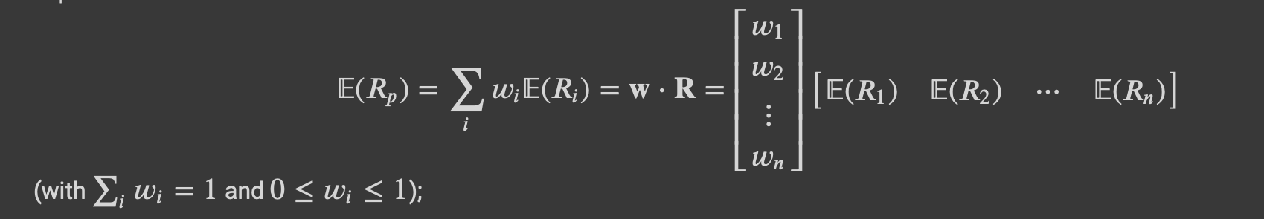
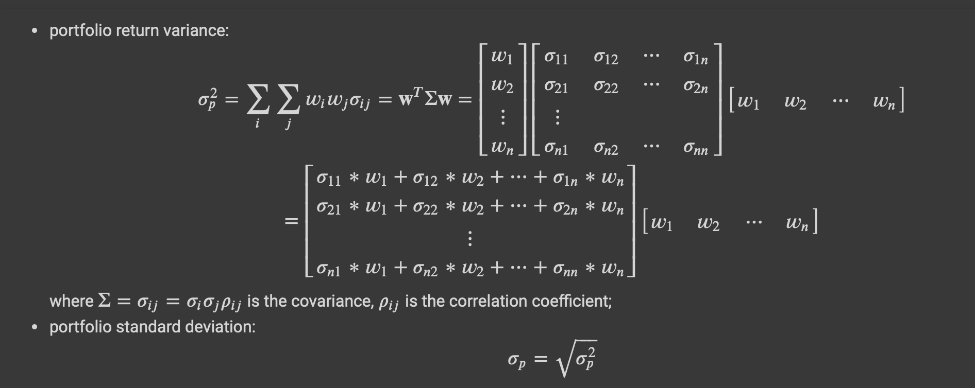

Slide 5
The project
My goal was to find the optimal portfolio of a set of assets, I divided the project in 6 steps :
1- I optimize the portfolio with the given data (historical series)
2 – I defined the efficient frontier combining the volatility and the expected return
3 – I represented the capital allocation line, combining to the portfolio a risk free asset
4 – I defined the sharpe ratio of the portfolio
5 – I made the CAPITAL ASSET PRICING MODEL (CAPM)
6 – Finding the best 10 asset using Multifactor model

Slide 6
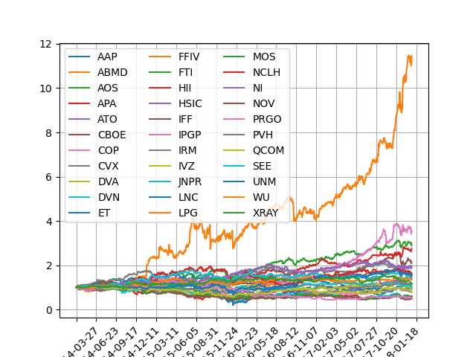
1. Plotting historical data series
As a first step, I downloaded the historical data series of the assets, and with them, I created an initial plot to identify their potential paths in the market.

Slide 7
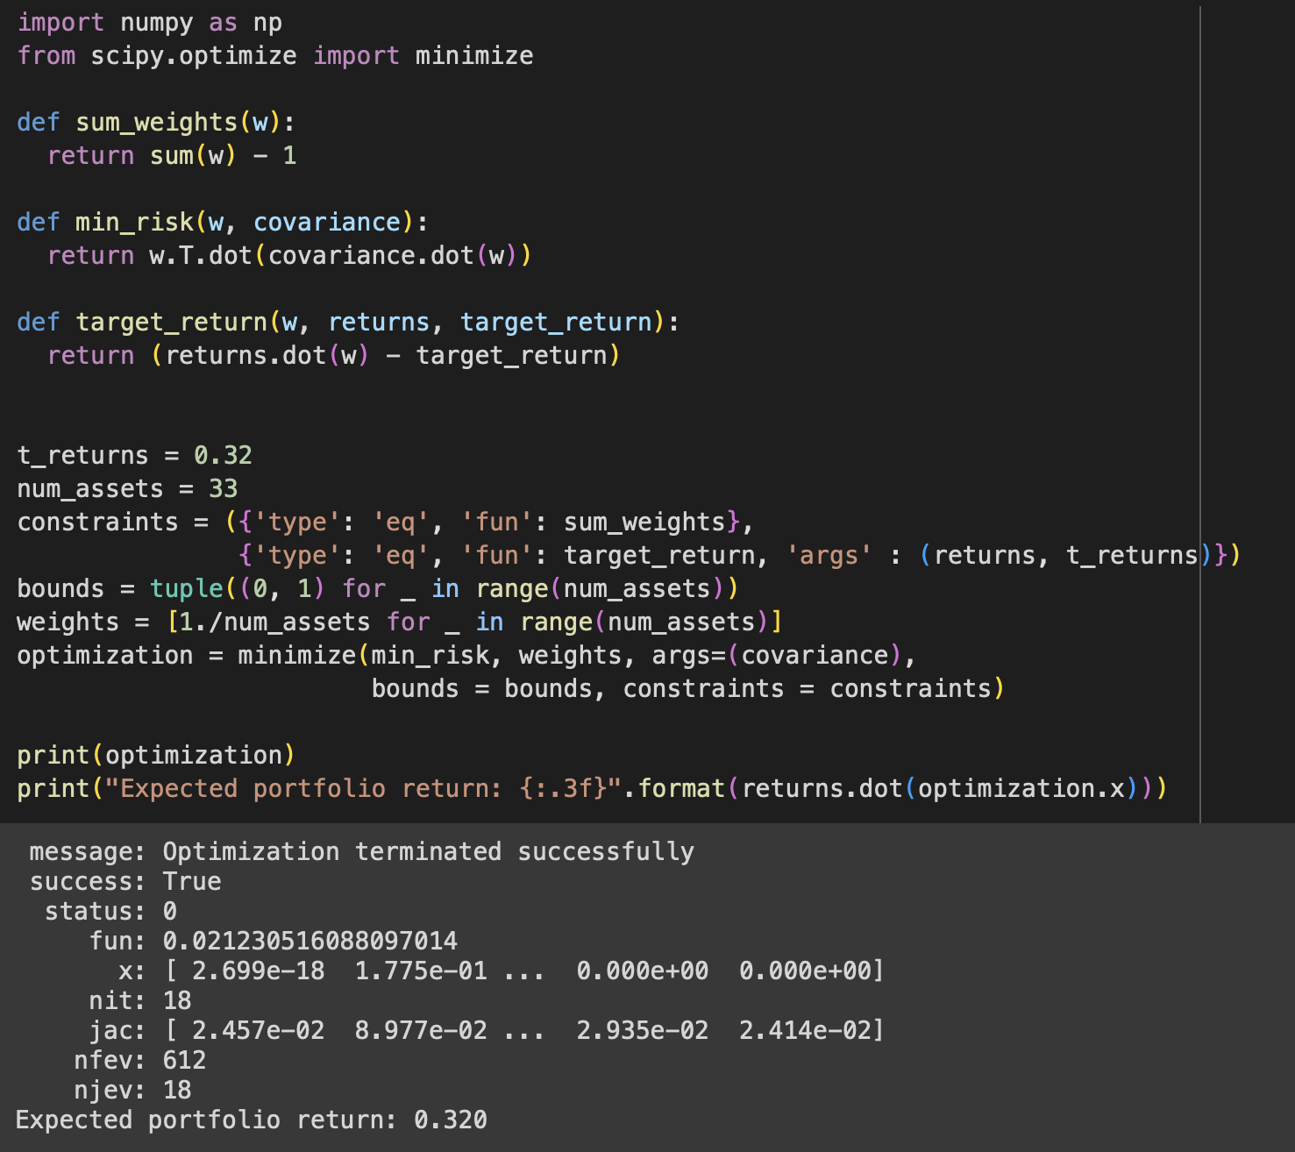
1. Optimization
After calculate covariances and returns ofr historical data series.
I adopted the optimization process, obtaining as result : the optimal weights of the assets inside the portfolio.

Slide 8
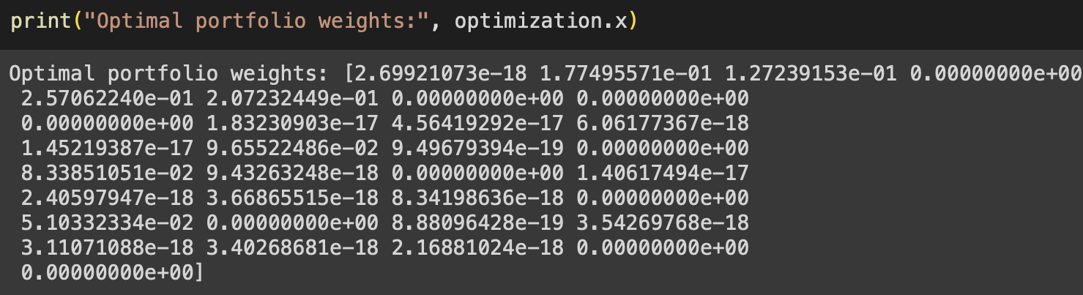
1. Optimal portfolio weights
Optimal portfolio weights of the 33 assets

Slide 9
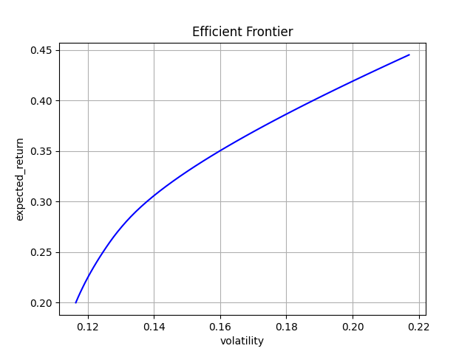
2. Efficient frontier
I plotted the efficient frontier curve as part of the optimization process.
This allowed me to minimize risk and determine the expected return across a range of target returns between 0.20 and 0.45.

Slide 10
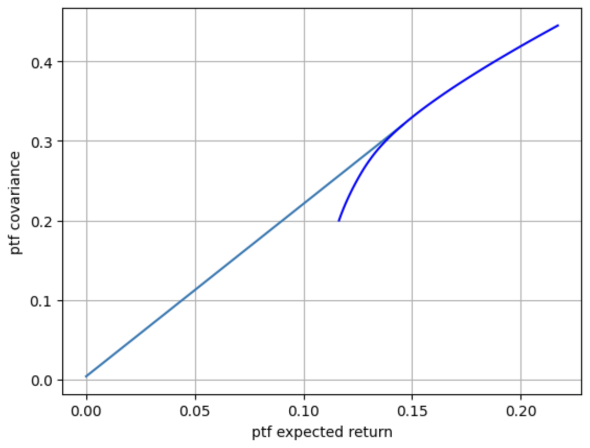
3. Portfolio with risk free asset and cal
In the third step, I combined to my portfolio of risky asset a risk free asset.
The risk - return combinations of the risk free investment and a risky portfolio lie on a straight line connecting the two investments : the capital allocation line (CAL)

Slide 11
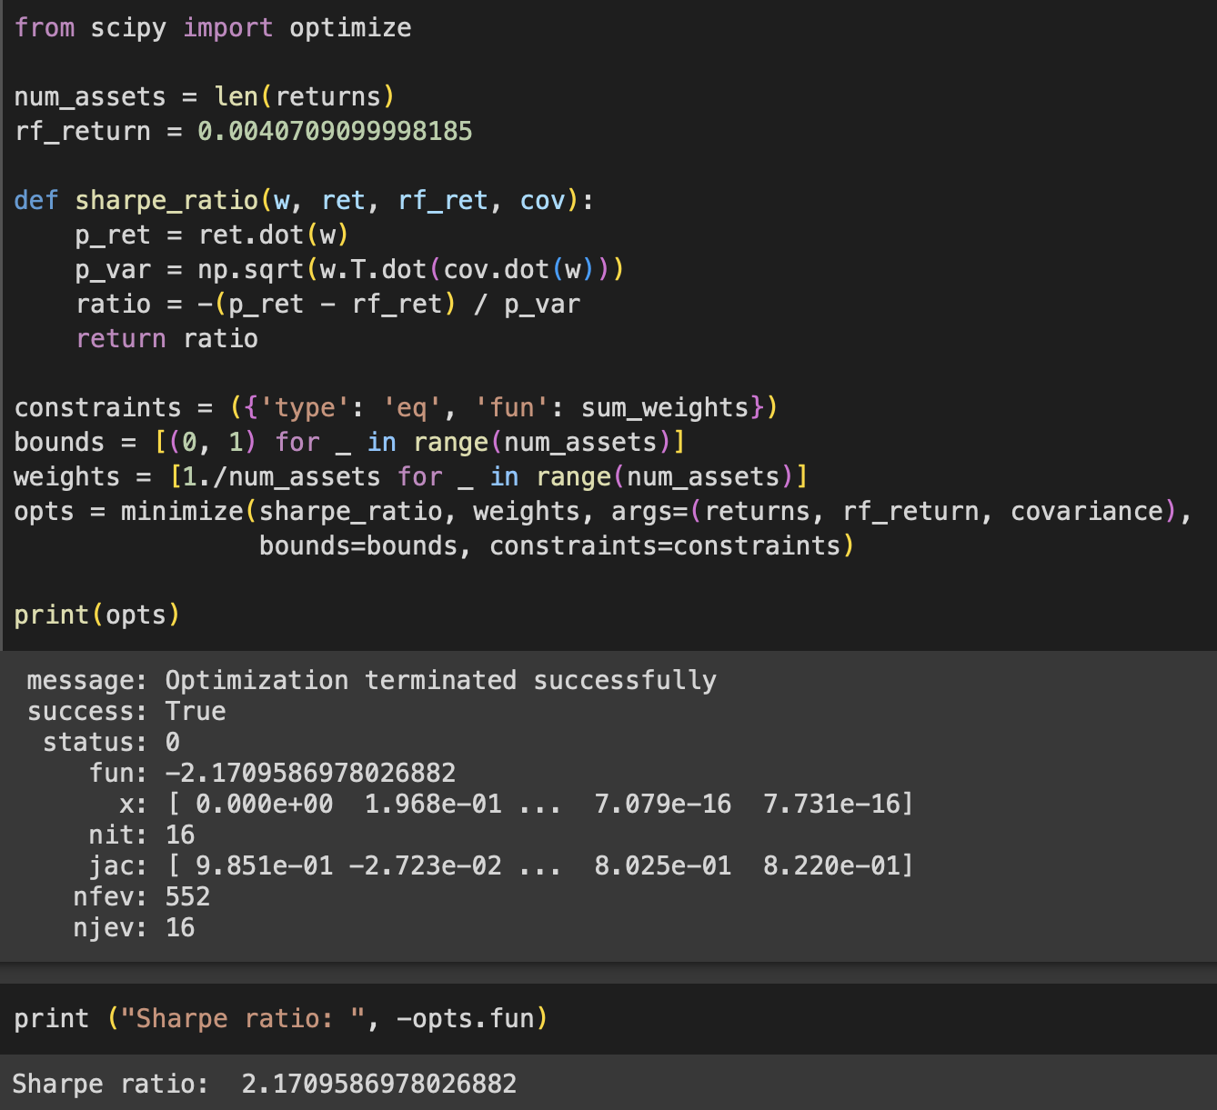
4. SHARPE RATIO
In the fourth step I again used the optimization process, in that case to define the sharpe ratio.
We have to remember that the sharpe ratio is an important measure that evaluate the excess return for bearing risk instead risk free
In my condition the sharpe ratio has a value of 2.17, which is rated as very good.

Slide 12
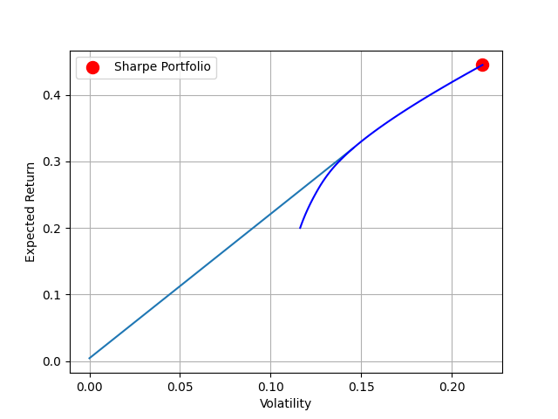
Here we can see a final plot between efficient frontier, capital allocation line and sharpe ratio

Slide 13
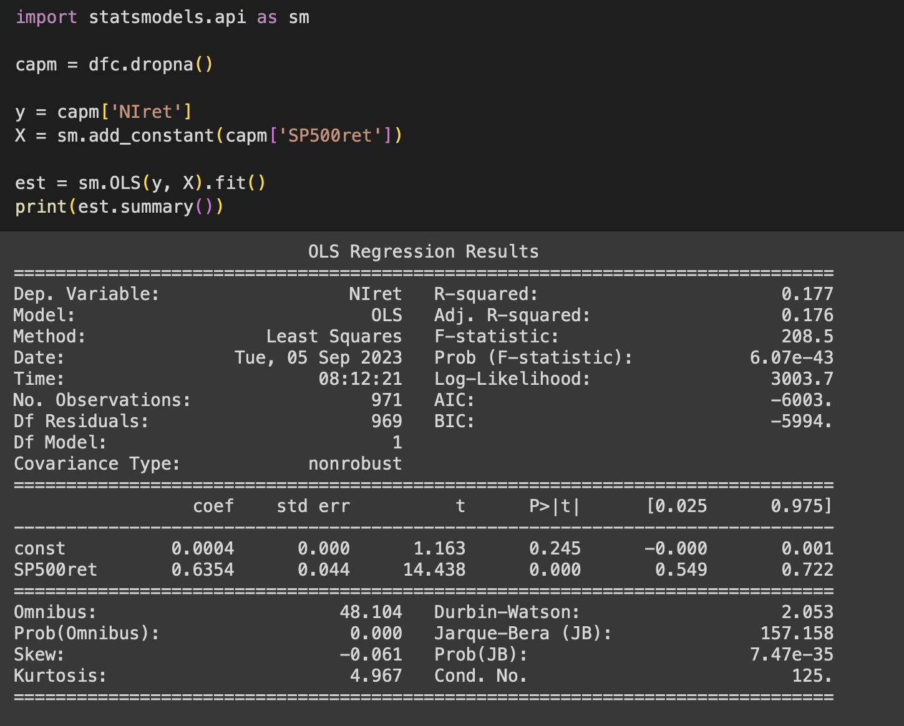
5. CAPITAL ASSET PRICING MODEL
Using the return of a single risky asset in, that case NI (NiSource quoted in the NYSE).
I made the first linear regression.

Slide 14
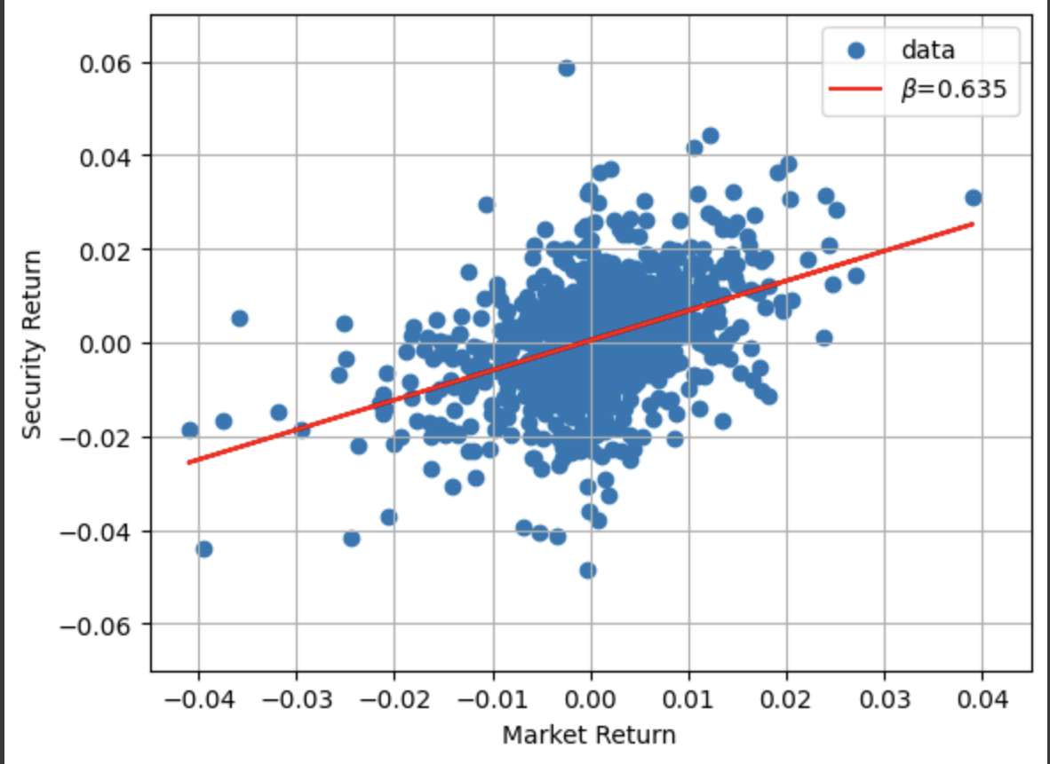
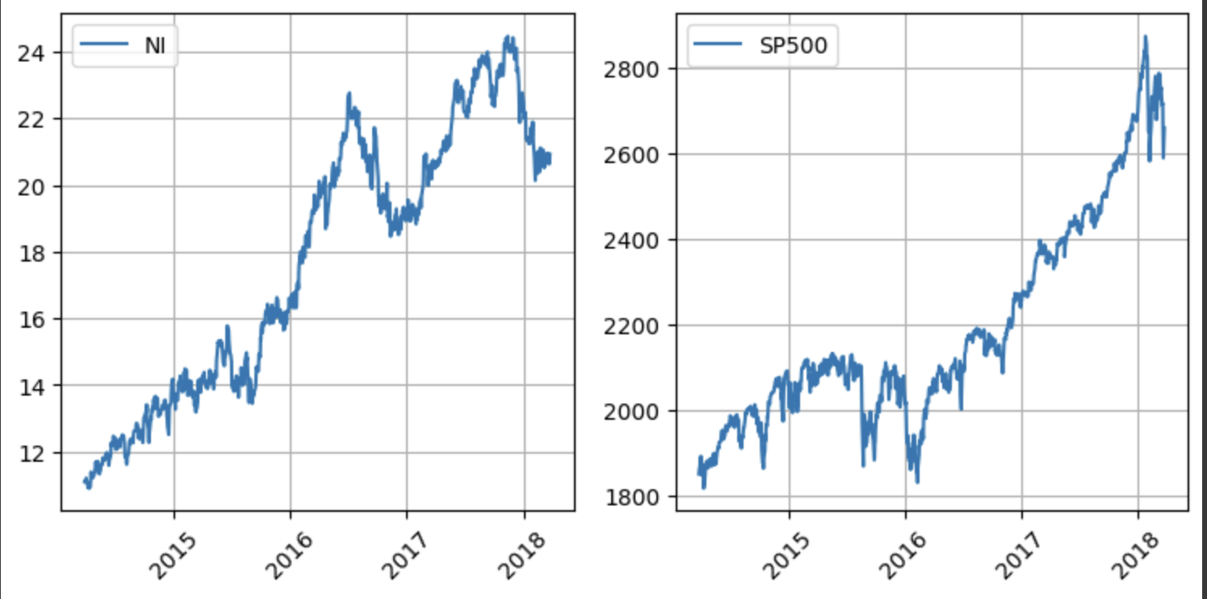
5. CAPITAL ASSET PRICING MODEL
1- the scatter plot, on the left, represents the return of the asset and it’s beta correlated to the market, in this case the SP500
2 – The second graph, on the right, shows the correlation of the asset with the market return (SP500)

Slide 15
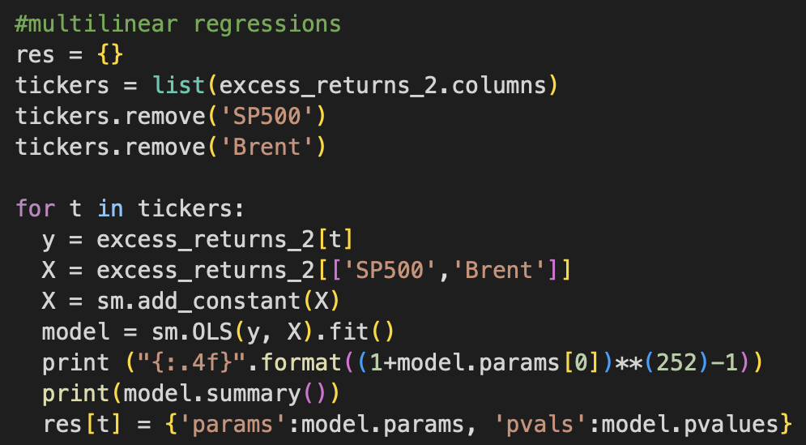
6. MULTIFACTOR MODEL
As last point I had to calculate a multilinear regressions for all the assets in my dataframe.
The goal of this point was to identify the best 10 assets, considering decreasing of brent’s value

Slide 16
RESULT OF MY ANALISY AND CONCLUSION
TICKERS | R^2 | ALPHA (⍺) | BETA (β) | P-VALUE
AOS | 0.458 | 0.0064 | -0.005 | 0.730
FFIV | 0.239 | 1.63 | - 0.0096 | 0.628
HTI | 0.276 | 0.0010 | - 0.0142 | 0.437
IPGP | 0.242 | 0.0070 | - 0.0478 | 0.045
NCLH | 0.241 | 0.0047 | - 0.1368 | 0
SEE | 0.324 | 0.0017 | - 0.0580 | 0.001
JNPR | 0.225 | 0.0011 | - 0.0022 | 0.919
HSIC | 0.319 | - 0.0045 | - 0. 0836 | 0
XRAY | 0.292 | - 0.0059 | - 0.0493 | 0.001
QCOM | 0.248 | 0.0026 | 0.0027 | 0.9
At the end of my analysis i choose my best 10 asset basing them on R^2, alpha, beta and p-value

Slide 17
SUMMARY
the analysis was performed taking consideration of the R^2 and imposing a greater or equal value that would avoid me discarding the asset (following a general investigation, the minimum value that I identified was 0.2 ).
Subsequently, for each regression I assumed the value of the alpha which indicated the performance of the asset and the beta (the latter it had to be negative. The goal was to identify the stocks that had an opposite trend to the Brent, for a purpose of investment protection).
Subsequently, for those assets that could not be attributable to a negative correlation with the path of oil (negative beta), my research introduced a further element, namely the p-value. For the latter, the evaluations were carried choosing a p-value that exceeded 0.05 even if with a slightly positive beta, but still close to zero and an alpha and R^2 that met the initially requested implications.

